Slide 1
CSc 134
Database Management Systems
9. Indexing Structures for Files
Ying Jin
Computer Science Department
California state University, Sacramento

Slide 2
Single-level ordered indexes
Structure
  Ordered index file
    Small, easy to do binary search
  A list of pointers to disk blocks
Dense index vs. sparse (nondense) index
  Dense: One index entry for every record of data files.
  Sparse: Has index entries for only some of the search values.
Primary index
Clustering index
Secondary index

Slide 3
Primary Indexes
Specified on the ordering key field of an ordered file of records.
Ordering key field is used to physically order the file records on disk.
Index file consists of index entry (or index record)
index entry: <primary key, pointer to disk block>
index entry i: <K(i), P(i)>
1 index entry --- 1 block in the data file
Anchor record of the block (block anchor): first record in each block of the data file.
Dense index or spare index ☺?

Slide 4
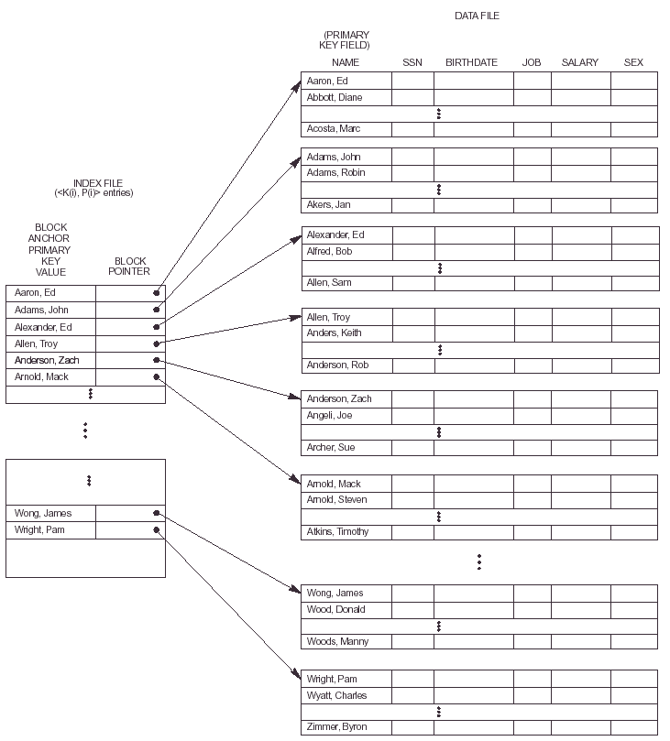

Slide 5
Access a record
Load blocks of index files
Search in index files
load corresponding data file

Slide 6
Average time to access a record
B: block size, R: record size, r: total number of records.
blocking factor bfr=⌞B/R ｣ records per block
A file has b block: b = r/bfr
A file with b block, binary search to find a specific record needs to access log₂b block
  Linear search b/2.
Example1
r=30,000, B=1024, R=100.
  How many block accesses are needed for a binary search on the data file?

Slide 7
Example 1 (Cont.)
Use primary index
  ordering key field: V=9 bytes, a block pointer P=6 bytes.

Slide 8
Clustering Indexes
Files are physically ordered on non-key field – clustering field
Clustering field does not required to have distinct value.
Clustering index
<index field, pointer>
  1 entry for each distinct value of the clustering field.
  a pointer to the first block in the data file that has a record with that value for its clustering field.
Figure

Slide 9
Insertion
Make insertion more efficient:
It is common to reserve a whole block (or a cluster of contiguous blocks) for each value of the clustering field.
Figure

Slide 10
Secondary Indexes
Provide a secondary means of accessing a file for which some primary access already exists
Index entry
  index field: nonordering field of the data file
  pointer: either a block pointer or a record pointer

Slide 11
Secondary indexes
Secondary key: Index field has a distinct value for every record
One index entry for each record in the data file
e.g. Block pointer (figure)
  Load and search index block
  Load appropriate block
  A search for the desired record within the block
Dense index

Slide 12
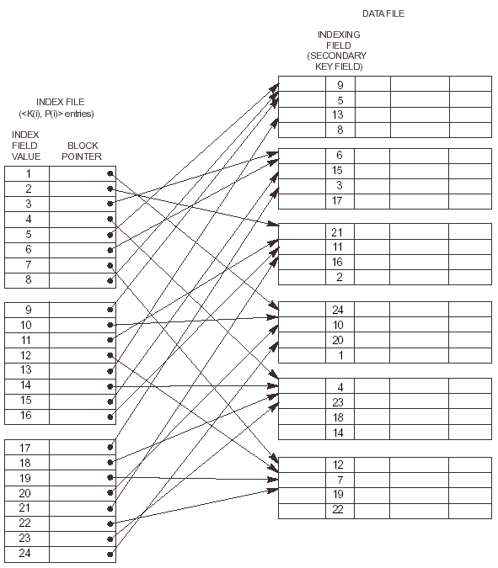

Slide 13
Example 2
r = 30,000, R=100, B=1024, b=3000
Linear search
  Require b/2=3000/2 = 1500 block accesses on the average
Secondary index on non-ordering key field
v=9, P=6

Slide 14
Secondary index on a non-key field
Numerous records in the data file can have the same value for the indexing field
Options for implementation
    1. Several index entries with the same K(i) value – one for each record.
    2. Variable-length records for the index entries
    <K(i), <P(i,1),..., P(i,k)>
    3. <K(i), P(i)> points to a block of record pointers (figure)
    If some K(i) occurs in too many records (pointers cannot fit in one block), a cluster or linked list of blocks is used. Figure

Slide 15
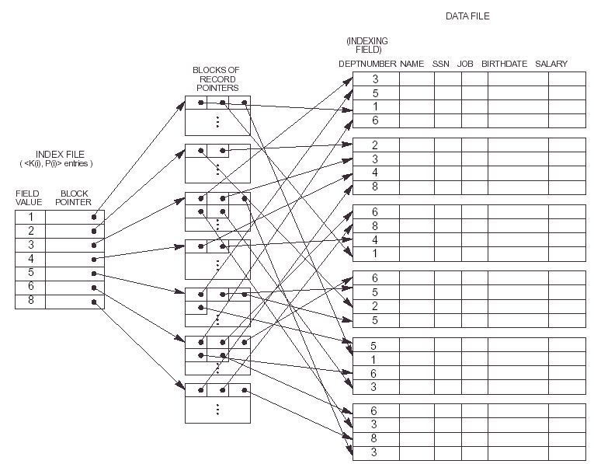
Option 3

Slide 16
Multilevel Indexes
Idea
  If the first level needs more than one block of disk storage → require a second level index
  If the second level needs more than one block of disk storage → require a third level index
  ...
  Repeat the preceding process until all the entries of some index level t fit in a single block

Slide 17
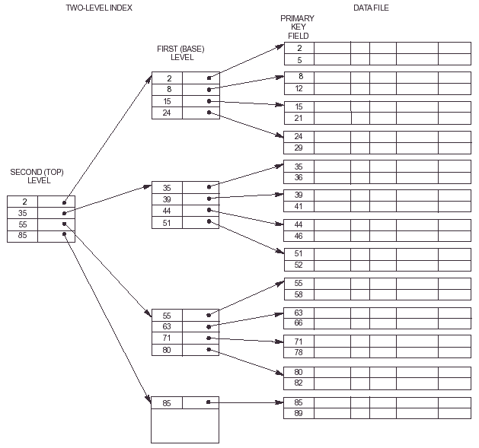

Slide 18
Multilevel indexes (Cont.)
bfr_{i} is called fan-out of the multilevel index.
Refered as fo.
In any level, bfr_{i} = fo (# of record per block)
  Reason: all index entries are the same size
r1: total number of records in level 1
the 1st level needs (r1/fo) block
= # of entries needed at the 2nd index level
= r2 = (r1/fo)

Slide 19
Multilevel indexes (Cont.)
the 2nd level needs (r2/fo) block
= # of entries needed at the 3rd index level
= r3 = (r2/fo)
Approximately t level index, such that r1/((fo)^{t})>=1
A multilevel index with r1 first-level entries will have approximately t level, where
t = log _{fo} (r1)

Slide 20
B-Tree
All leaf nodes are at the same level
Figure
Internal node of a B-tree
<P1, <K1, Pr1>, P2, <K2, Pr2>, ..., <Kq-1,Prq-1>, Pq>
Pi – tree pointer
Pri – data pointer (a pointer to the record whose search key field value = Ki, or to the data file block containing that record)

Slide 21
B-Tree (Cont.)
Within each node, K1<K2<...<Kq-1
For all search key field values X in the subtree pointed at by Pi
  Ki-1 < X< Ki, where 1<i<q
  X<Ki, where i=1
  Ki-1<X, where i=q;
Leaf nodes have the same structure as internal nodes except that all of their tree pointers are null

Slide 22
B⁺ Tree
Data pointers are stored only at the leaf nodes of the tree
The leaf nodes have an entry for every value of the search field, along with a data pointer to the record (or block) if the search field is a key field
The structure of leaf nodes differs from the structure of internal nodes
Internal notes of a B+ tree (figure)

Slide 23
Leaf node of a B⁺ tree
<<K1, Pr1>, <K2, Pr2>, ... <Kq-1, Prq-1>, Pnext>
Pri is a data pointer
Pnext points to the next leaf node of the B⁺ tree
K1 < K2 <... < Kq-1
Figure

Slide 24
These slides are based on the textbook:
R. Elmaseri and S. Navathe, Fundamentals of Database Systems, 7th Edition, Addison-Wesley.

